Slide 1
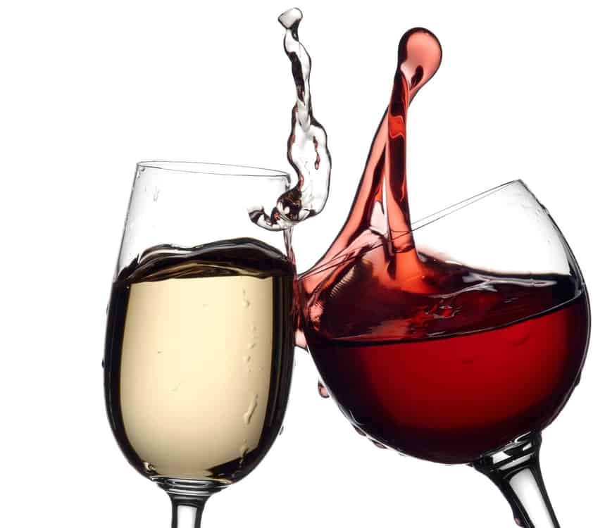
Wine Quality Analysis and Predictive Model
Jared Barnes

Slide 2
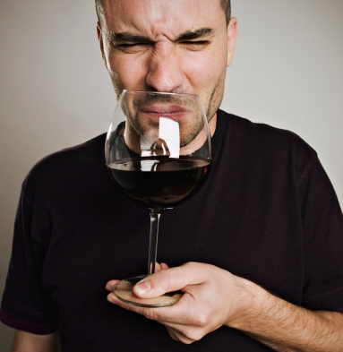
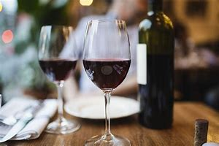
The Need
GOOD WINE
Takes time
Takes money
Takes many resources
BAD
Takes time
Takes money
Takes many resources
People LIKE this and buy it.
People DON’T LIKE this and DON’T buy it.

Slide 3
Solution
Determine a way to produce great wine, maximizing time, money, and resources.
This project does that.

Slide 4

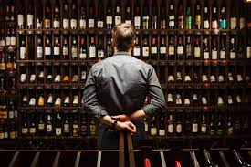

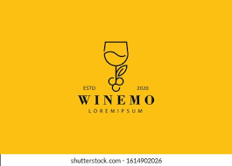
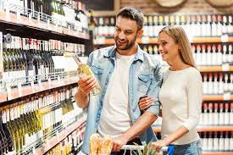


Who might care
3rd party sellers
Wine companies
Customers
Vineyards

Slide 5
Project Goal
TWO PARTS
Predict wine quality, using the 13 features of wine given in the data set.
Determine what features of wine GREATEST influence wine quality.

Slide 6
Plan
Import data
Clean data
EDA
Separate wines by “best quality” (wines with >= quality of 7 out of 10)
Split and scale data
Compare 3 algorithm Machine Learning models
Hyperparameter tune
Identify 3 most important features influencing best quality

Slide 7
Import Data
Contained these features:
wine type
pH
fixed acidity
volatile acidity
citric acid
residual sugars
chlorides
free sulfur dioxide present
total sulfur dioxide present
density
sulphates
alcohol content
wine quality
6497 rows (each wine = 1 row)
13 columns (wine features)
Target variable

Slide 8
Cleaning
Data set = relatively clean
Low % of null values
Removed rows with null values. In total, just 34 rows removed (out of original 6497).

Slide 9
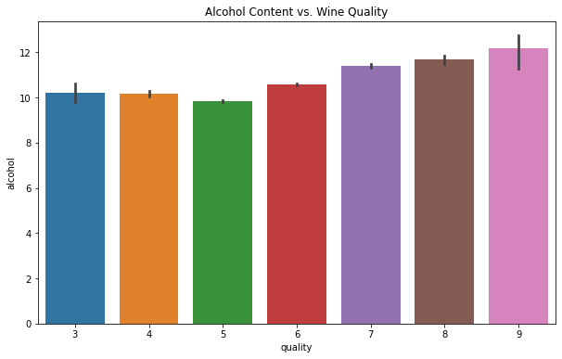
Exploratory Data Analysis
As quality increases, alcohol increases.
What are some common things that affect wine quality?
sugar
pH / acidity
alcohol
Only one with noticeable trend with wine quality.
Still must proceed to create model, though alcohol is clearly one of the “important features” to wine quality.

Slide 10
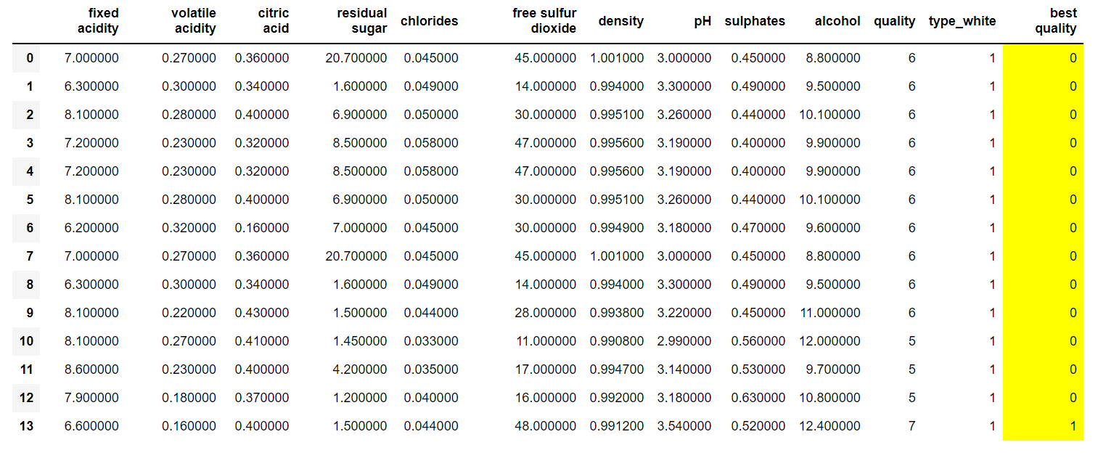
New column: new target variable
Created new column in dataset: “best quality”
1 = best quality wine (quality >=7)
0 = not best quality wine (quality <7)
New target variable = “best quality”

Slide 11
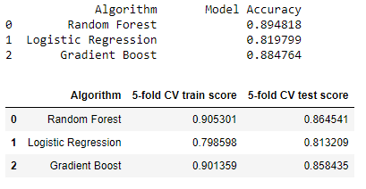
Algorithm Comparison
3 Classifier Algorithms:
Random Forest Classifier
Logistic Regression Classifier
Gradient Boost Classifier
Random Forest model performed the best, slightly better than Gradient Boost.
Parameter Results
Parameter tuning of Random Forest Model

Slide 12
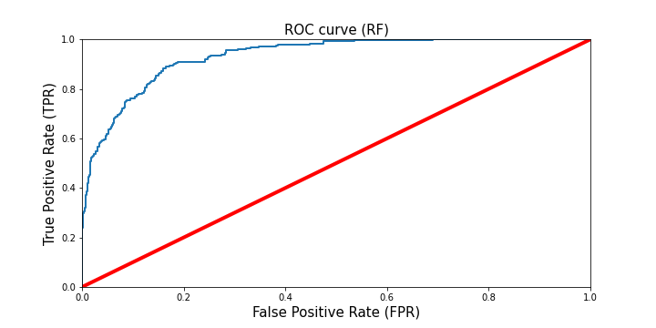
Predictive Effectiveness
Predictions curve trends toward true positives. Good news! Model is effectively predicting data.
Trained Random Forest Model to training data, tested with testing data
Produced ROC curve (True Positive Rate vs False Positive Rate)

Slide 13
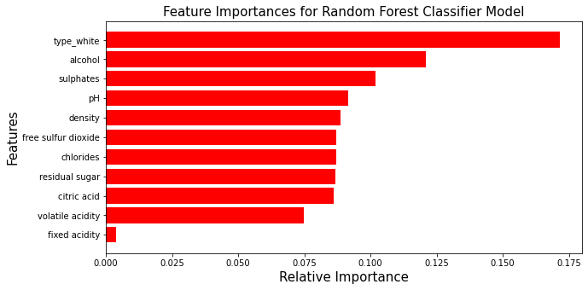
Which features are most important to best wine quality?
Calculated feature importance using the tuned Random Forest model
Top 3 most important features:
- wine type
- alcohol
- sulphates

Slide 14
Recommendations and going further
Focus on optimizing top 3 important features: wine type, alcohol, and sulphates
Determine ranges for each features that correspond with highest wine quality.
2.) Determine needs in obtaining price data and sales data for all wines.
With price and sales, you can determine which features lead to most sales for lowest cost.
3.) Consider collecting data for age and grape statistics for each wine
Deeper understanding of drivers in wine quality.

Slide 15
Questions?

Slide 16
For more detail, see GitHub repository for this project.
JaredBarnes6/wine_quality_capstone: Creating a predictive model to determine the quality of wine given a number of wine features. This process involved data cleaning, visualization, feature correlation analysis and engineering, comparing different machine learning algorithms and their models, cross validation and error analysis. (github.com)

